Slide 1
Dairy Cattle Breeding in the US
Prof. Prof. Dr. João B. Colé
ADSC 3110 | January 28, 2025

Slide 2
Topics for discussion
What is genetic improvement?
Who does it?
Why do we do it?
How do we do it?
What is our main
selection objective?

Slide 3
What is genetic improvement?

Slide 4
What influences a phenotype?
Phenotype = Genotype + Environment
The percentage of total variation attributable to genetics varies:
Female fertility: 0.04
Working life: 0.08
Udder health: 0.12
Milk production: 0.35
The percentage of total variation attributable to environmental factors is large:
Feeding/nutrition
Housing
Reproductive management
Notes:
4
4

Slide 5
What is the value of genetic selection?
Since 1957, management (dark blue) was 28% of gains, and genetics (light blue) was 71% of gains

Slide 6
Who does it?

Slide 7
Farmers drive genetic improvement
New York
360,783
Minnesota
204,077
Pennsylvania
283,390
Wisconsin
687,737
California
866,259
Texas
262,205
Texas
262,205
States with >200,000 DHI cows (01/2025)
States with >200,000 DHI cows (01/2025)

Slide 8
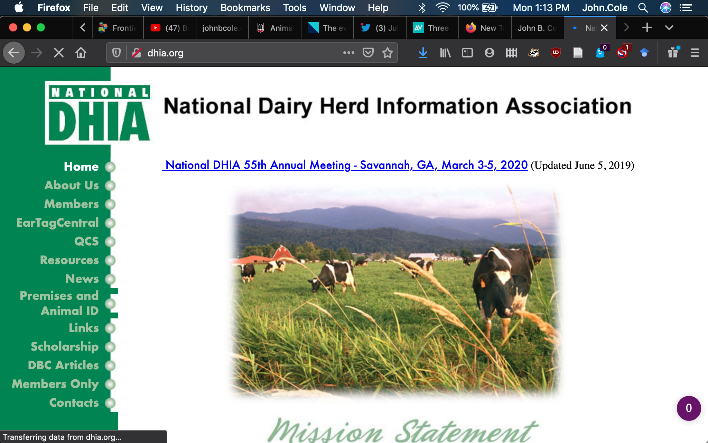

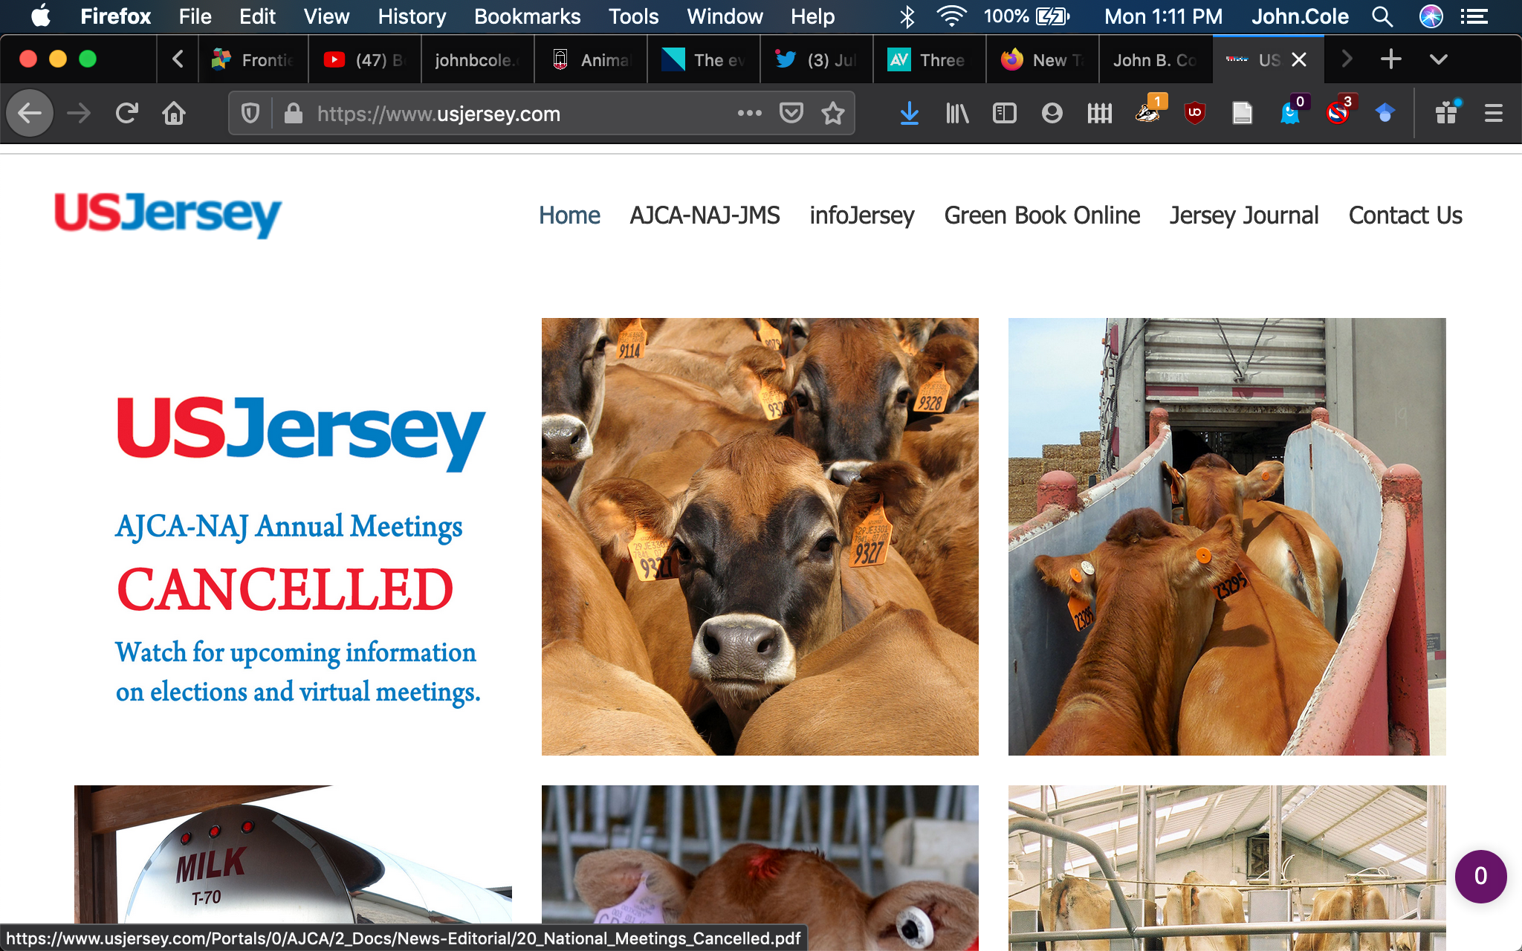
Where do data come from?
Data collected
on farms
Dairy records
processing centers
Analytical laboratories
National database
Genetic evaluation
center
Milk processing
plants
On-farm
system only
Non-milk
recording farms

Slide 9
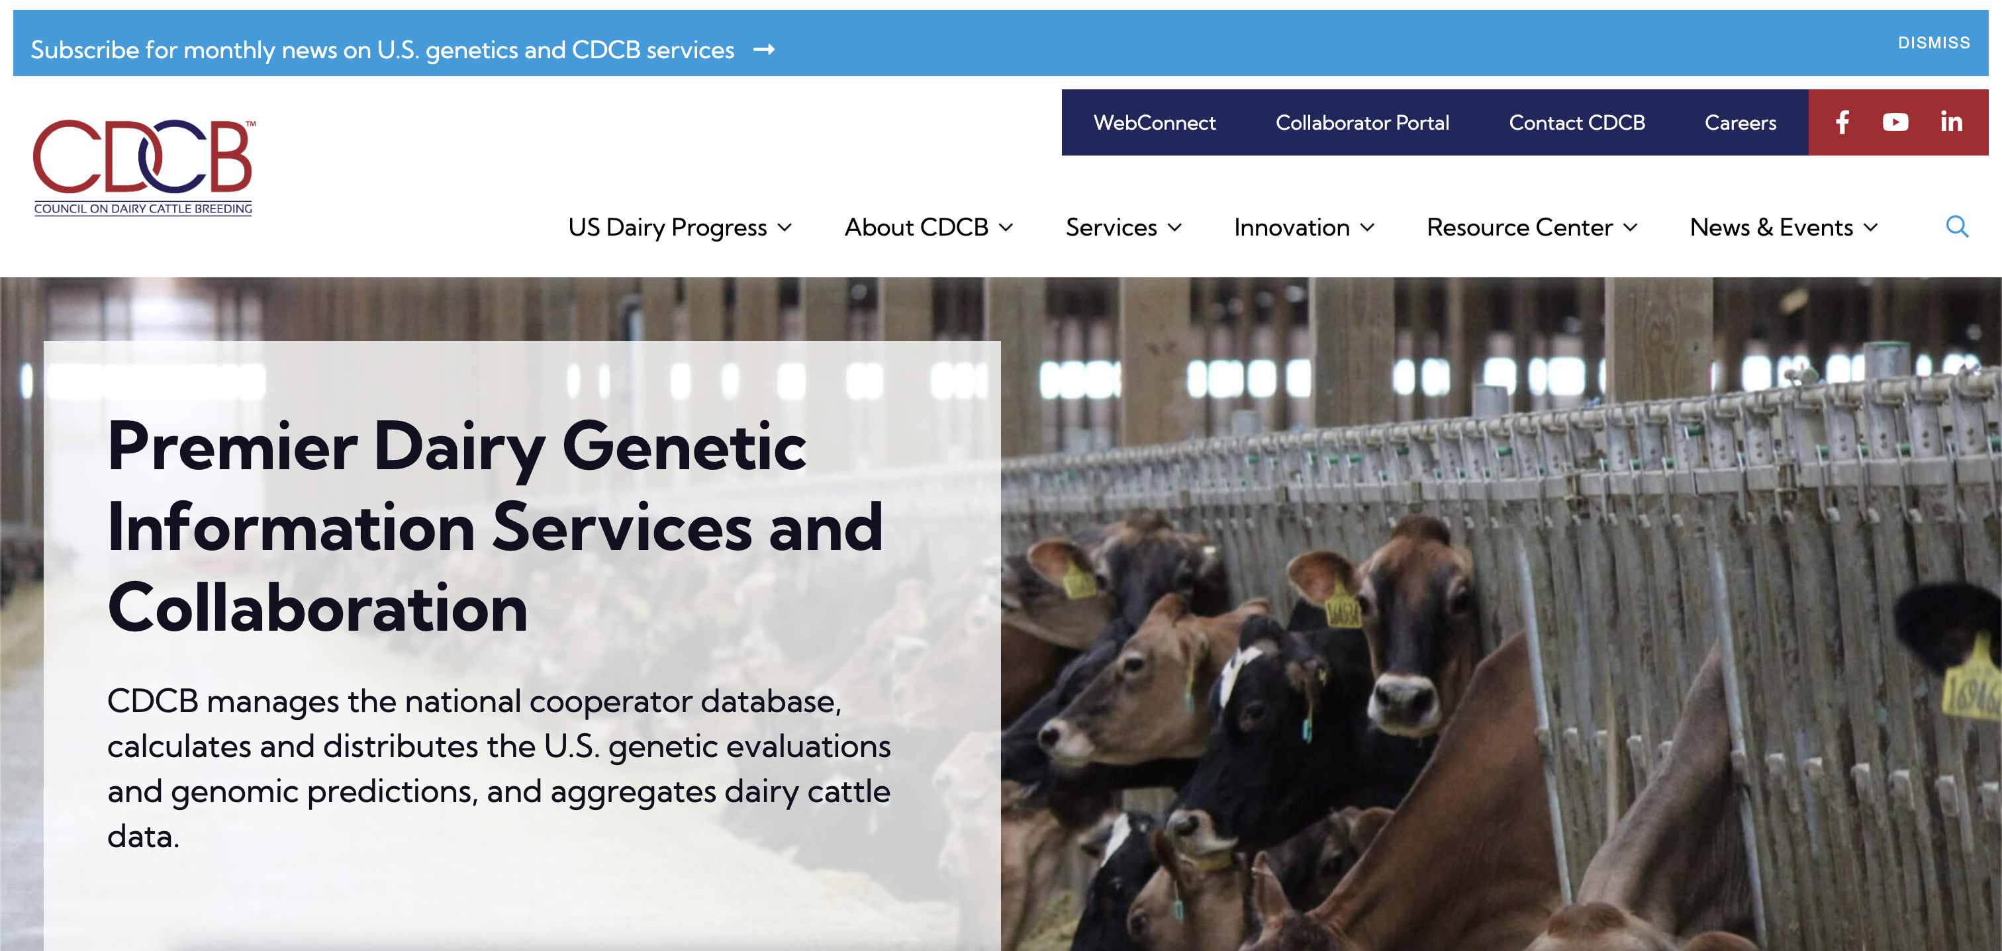
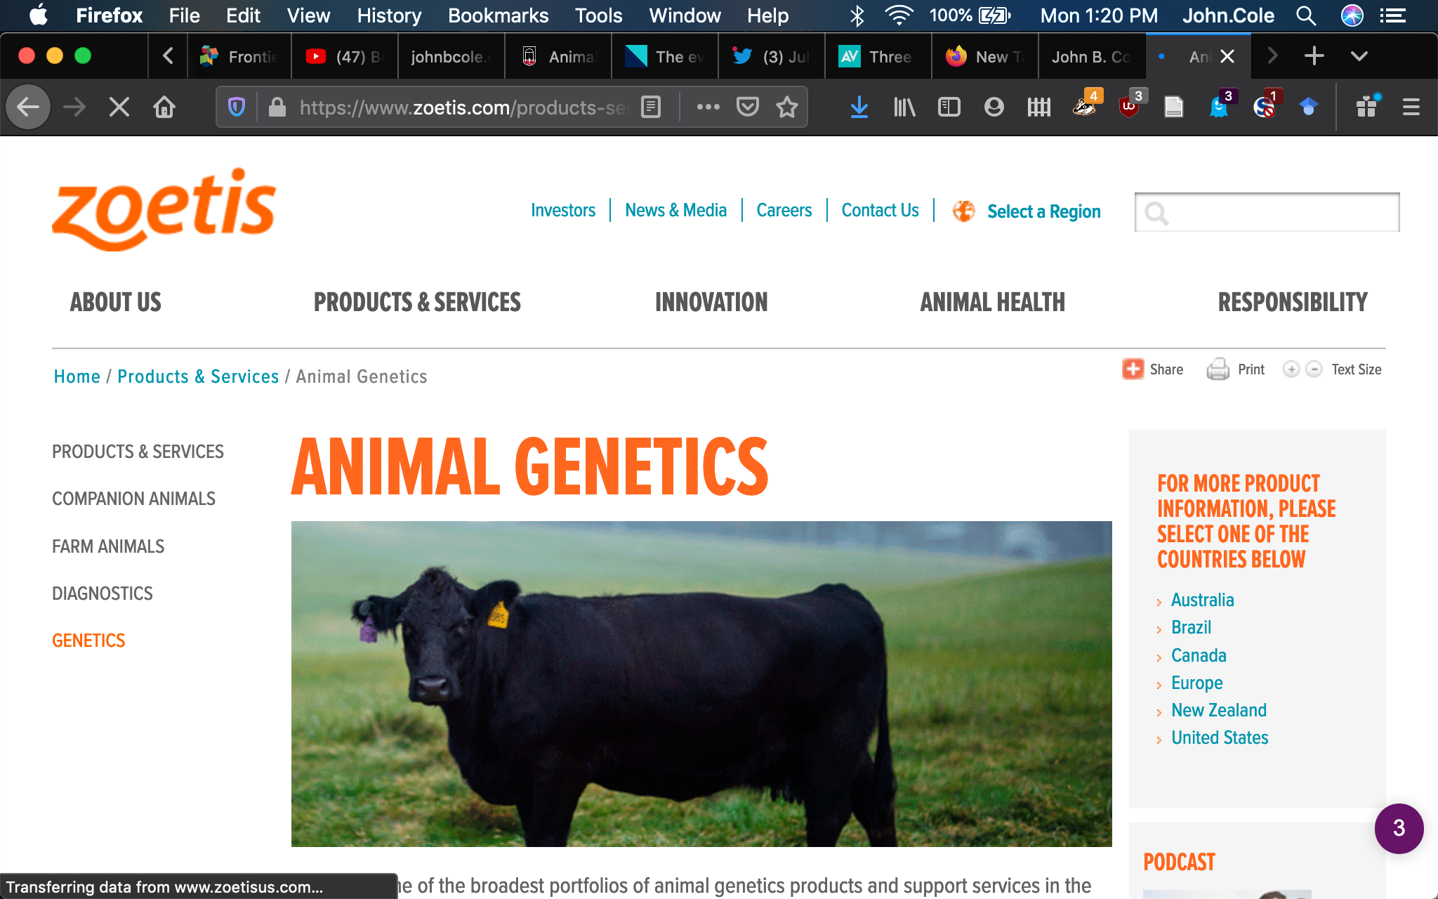
What about genomic information?
Animal manager/owner
DNA samples
DNA samples
genomic
evaluations
DNA laboratory
DNA samples
AI organization,
breed association
genotypes
genotypes
nominations,
pedigree data
genotype
quality reports
genomic
evaluations
Council on Dairy
Cattle Breeding (CDCB)

Slide 10
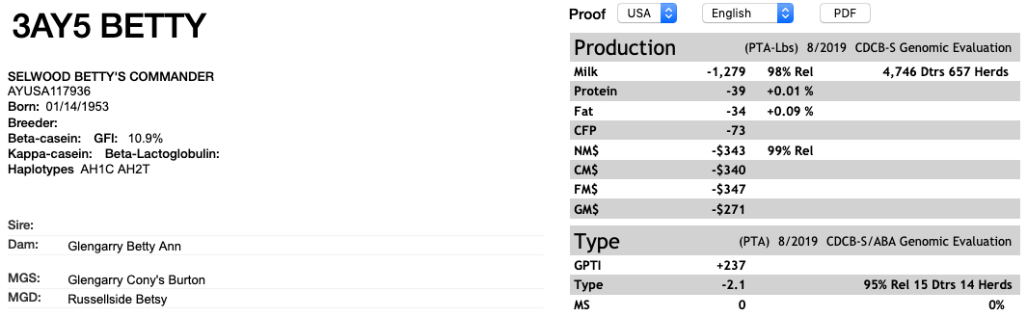
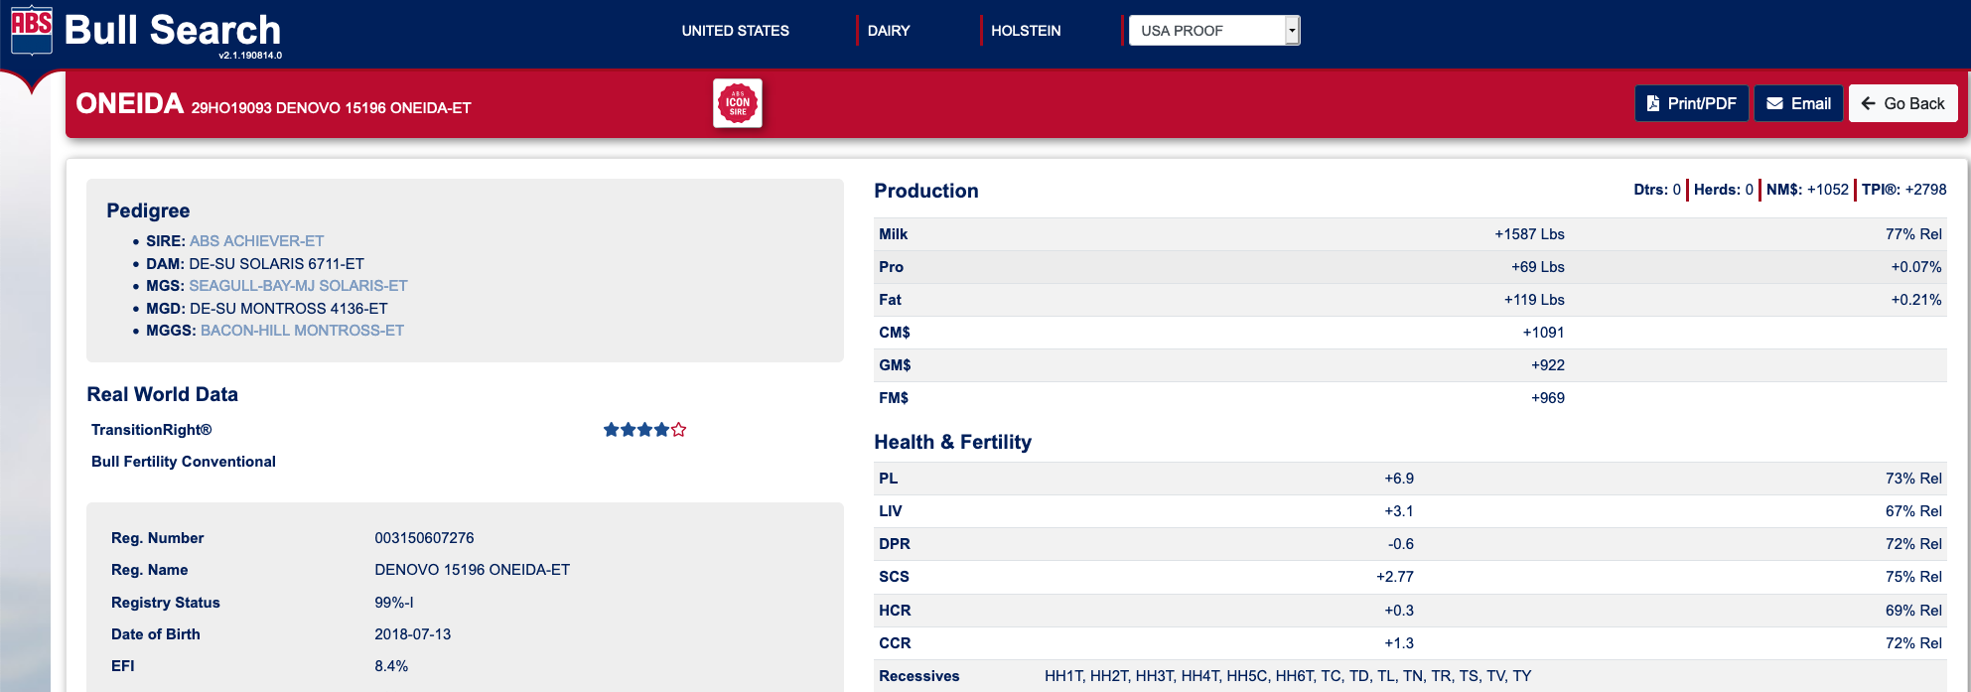
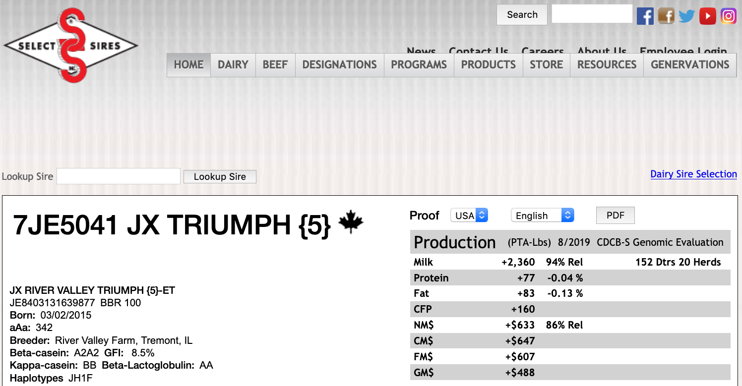
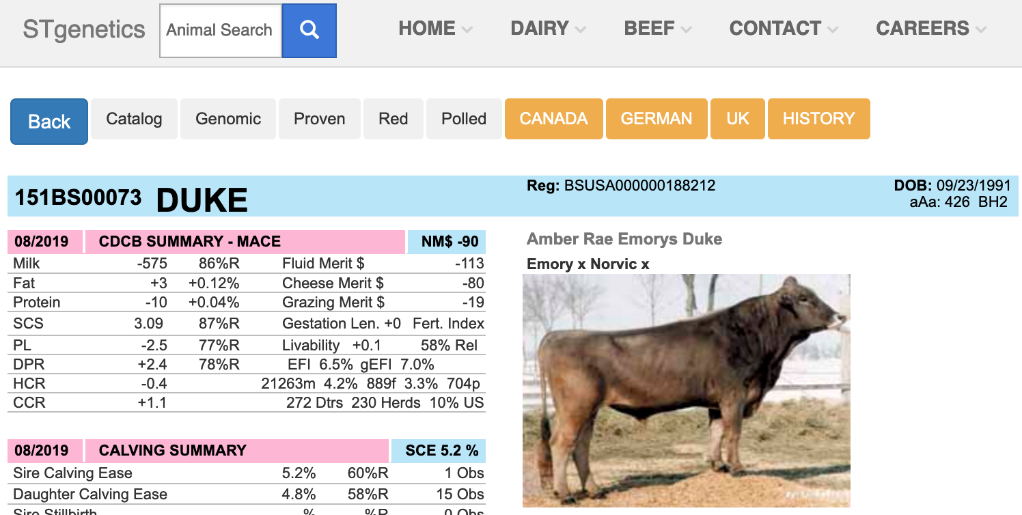
AI companies sell desirable genetics

Slide 11
Why do we need genetic improvement?

Slide 12
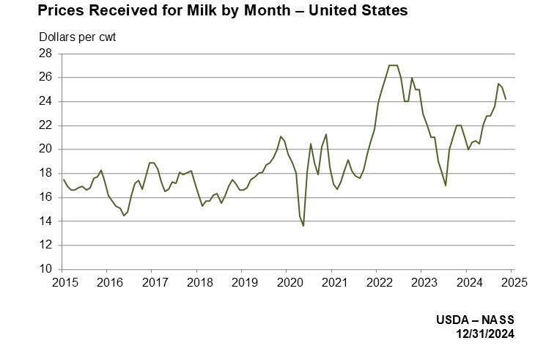
Milk prices are extremely volatile

Slide 13
Better genetics lowers production costs
PTA (predicted transmitting ability) represents ½ of the cow’s genetic merit.
A difference between herds of $439 in PTA NM$ means the cows in the better herd will produce $878 more net profit over their lifetime.
USDA’s calculations have the average 305-ME at 27,000 lbs. and cows milking for 3 lactations.
If the average cost of production per cwt is $18.00…
  A herd with an $878 advantage in the average genetic merit of their cows can produce milk at $16.92 per cwt.
  (Slide courtesy of Dr. Tom Lawlor, Holstein Association USA.)

Slide 14
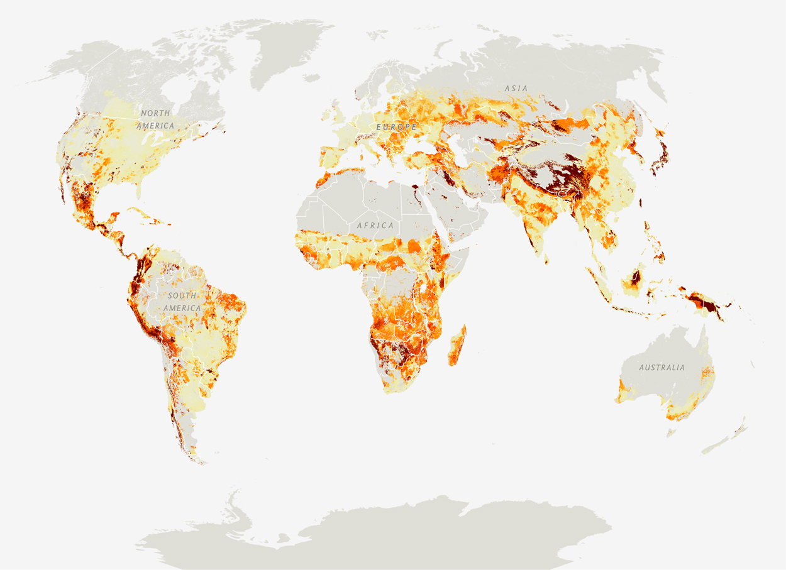
Production must increase as demand for food rises
Genetic gains are cumulative
Healthy farm economies support
healthy national economies
Increased efficiency reduces
environmental footprint
Source: National Geographic (https://www.nationalgeographic.com/foodfeatures/feeding-9-billion/)

Slide 15
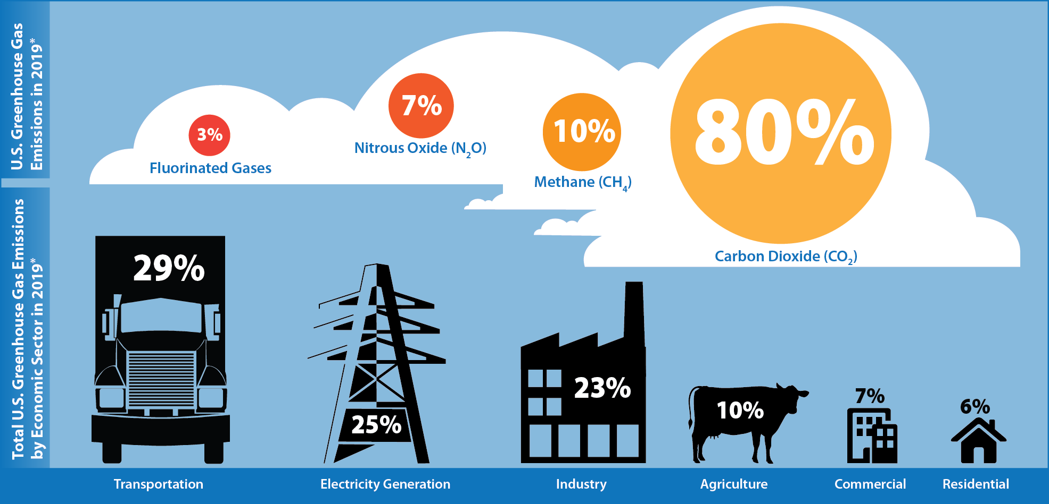
Environmental stewardship matters
Source: U.S. EPA (2021; https://cfpub.epa.gov/ghgdata/inventoryexplorer/).

Slide 16
How do we do it?

Slide 17
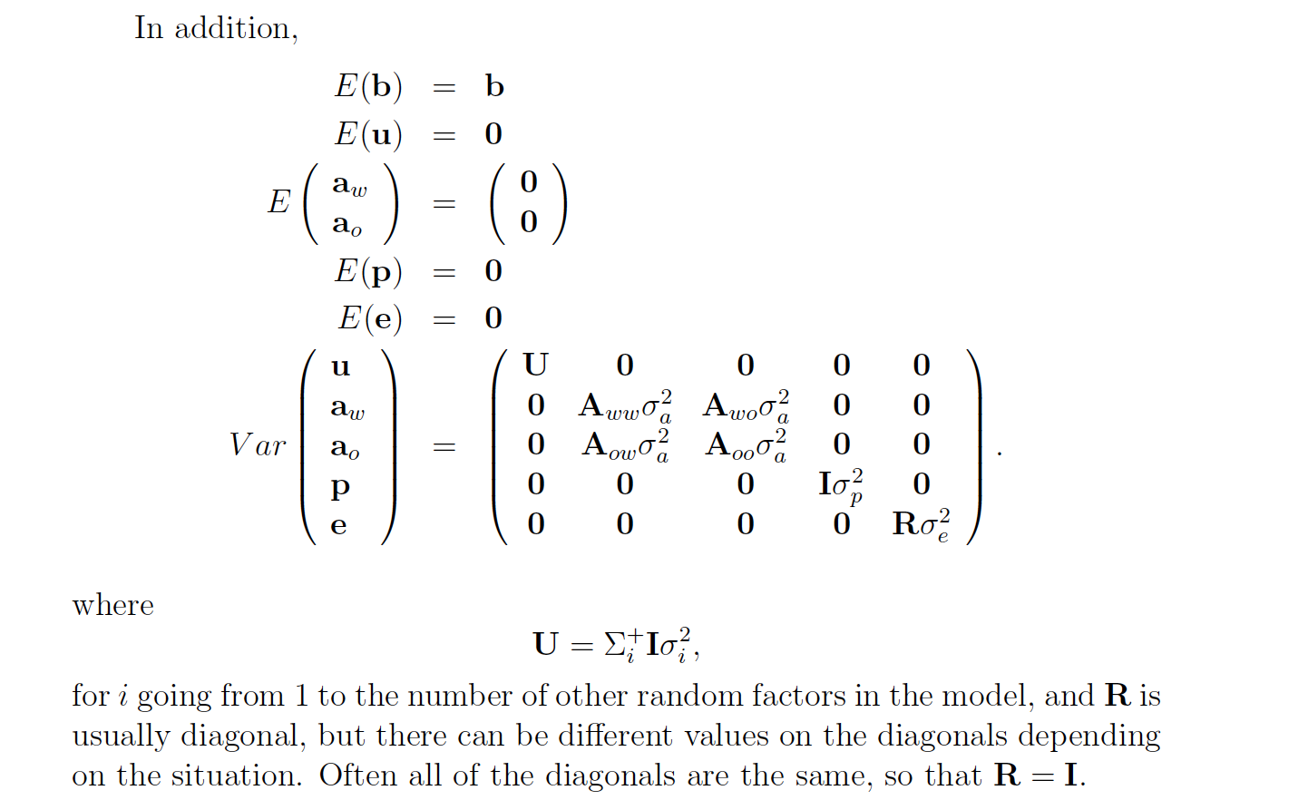
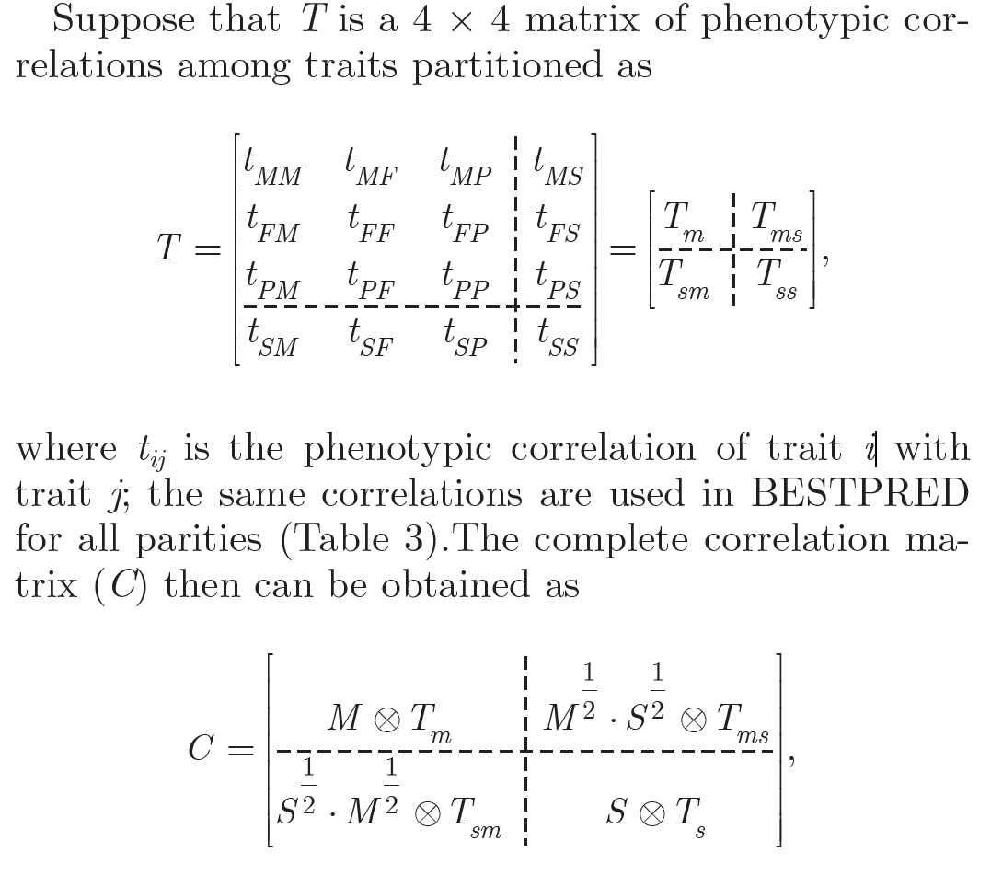
Genetics is just applied statistics!
Source: Cole et al., 2009; Schaeffer (2019).

Slide 18
How much data do we have?
Type of information | Number of records
Pedigrees | 75 million
Animal genotypes | 9.5 million
Lactation records | 105 million
Fertility records | 96 million
Health event records | 11 million
Calving difficulty scores | 39 million
Feed intake records | 10,000
Animals receiving evaluations | 80.5 million
Source: CDCB.

Slide 19
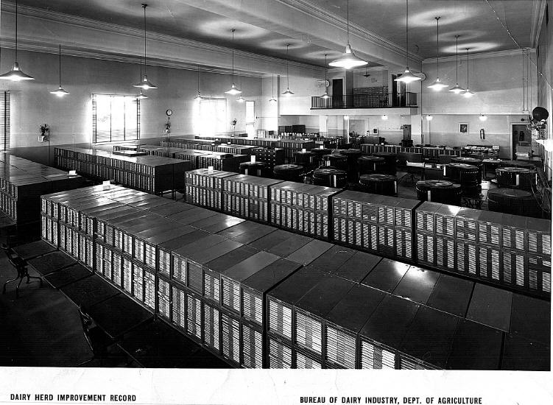
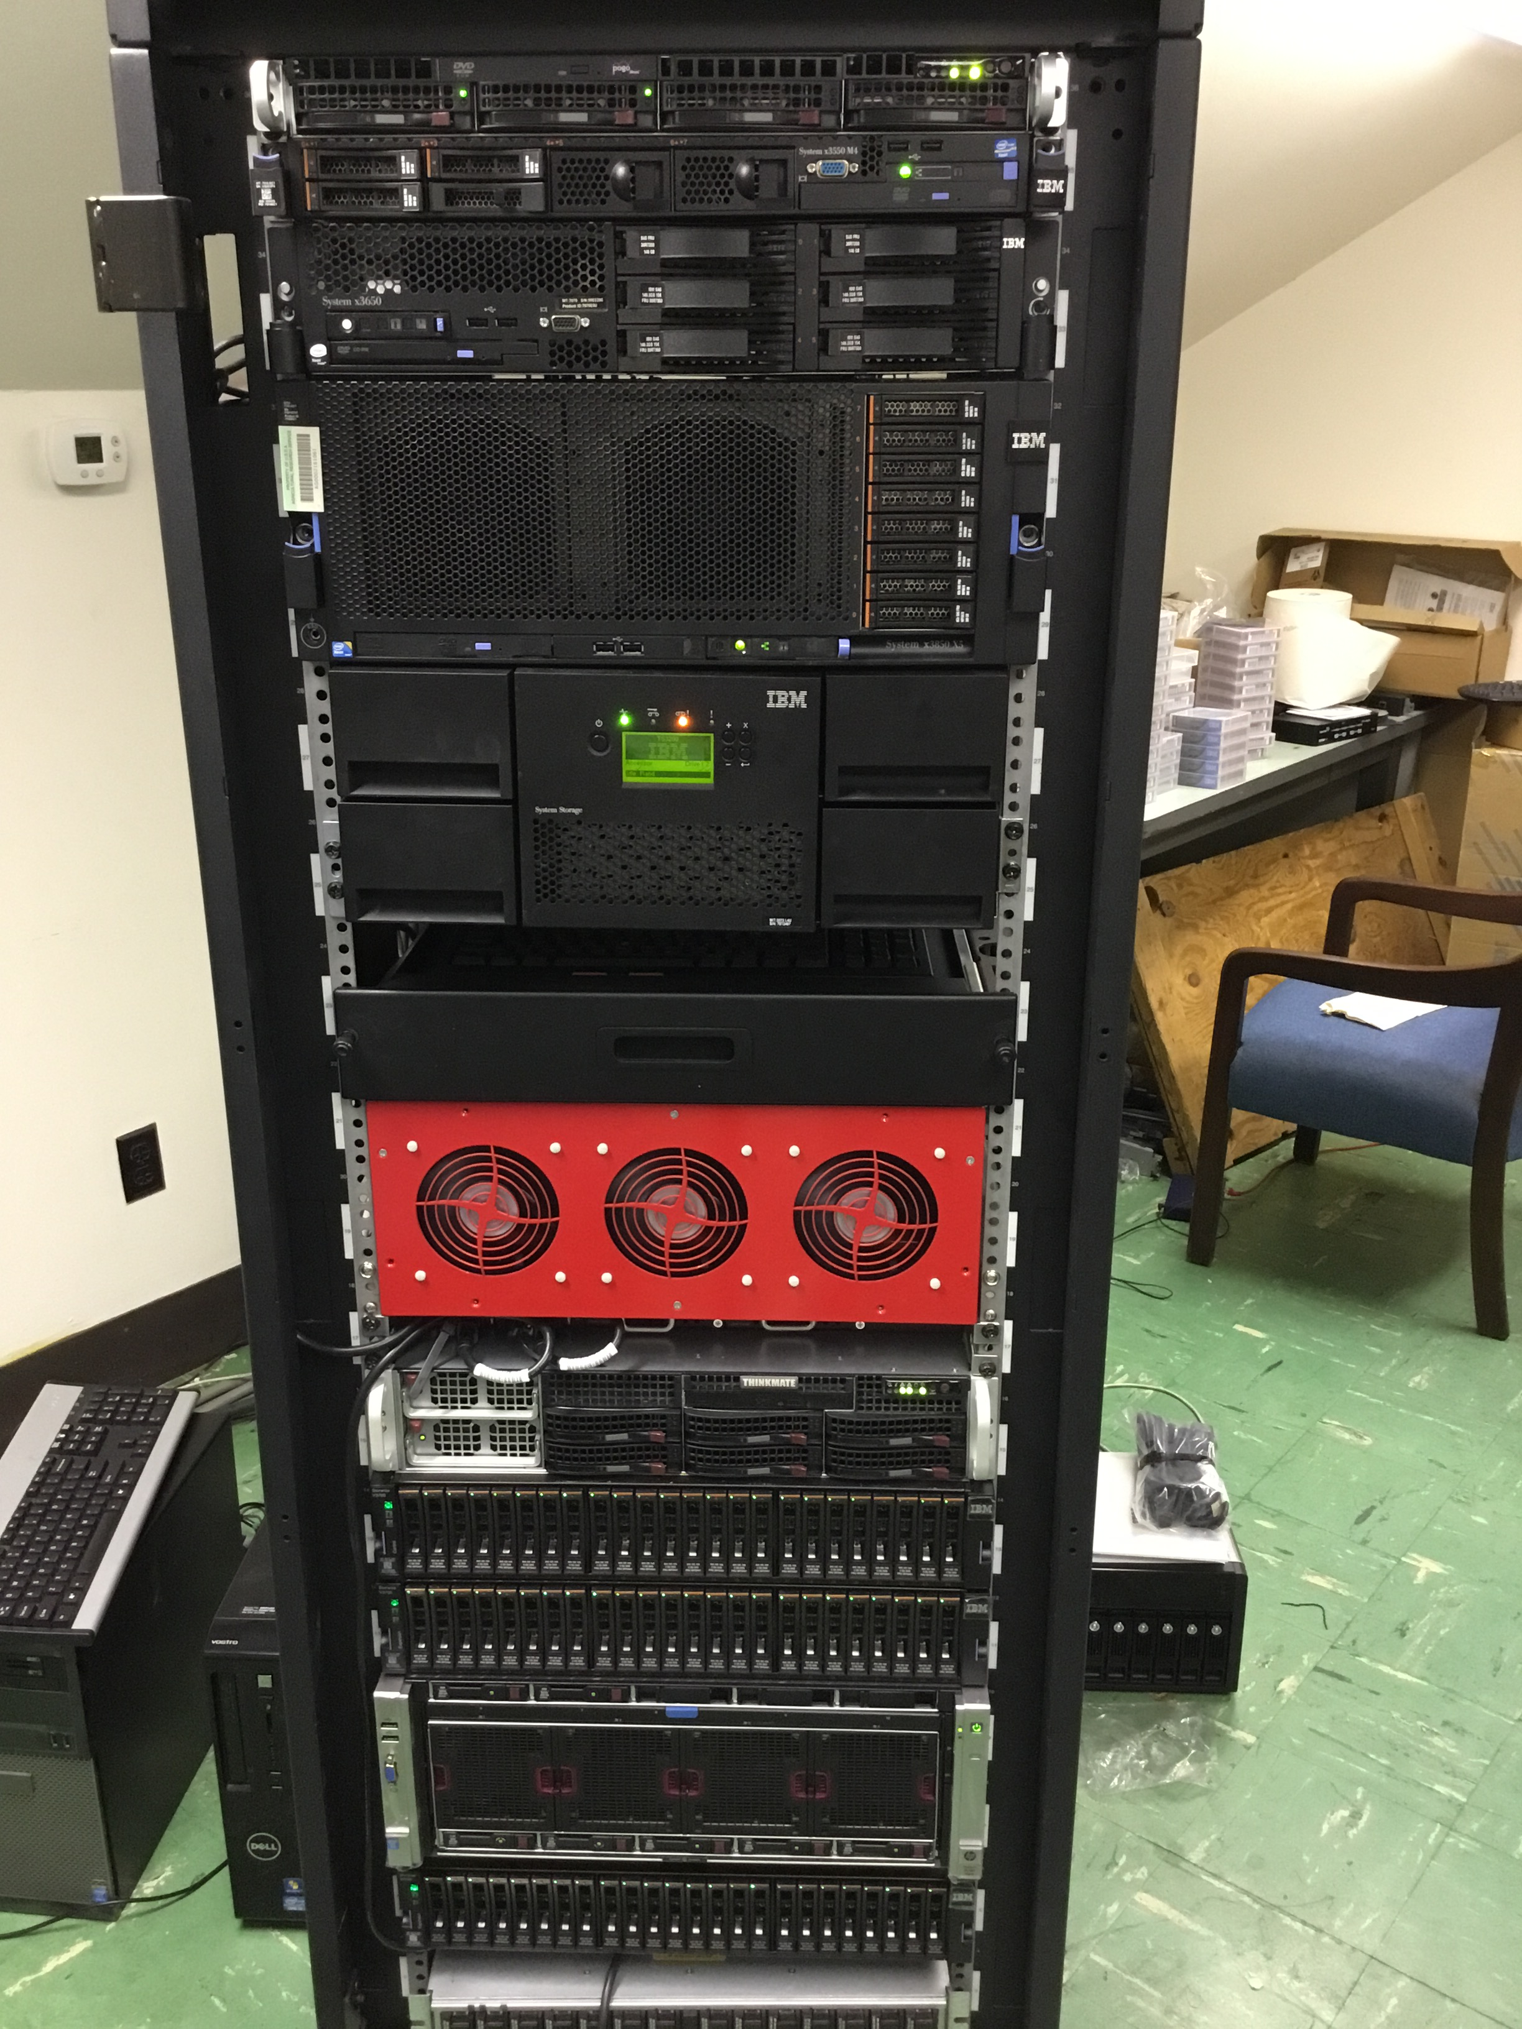
National Cooperators Database
1935
2015

Slide 20
Traits routinely evaluated in the US
Year | Trait | Year | Trait
1926 | Milk & fat yields | 2006 | Bull conception rate²
1978 | Conformation (type) | 2009 | Cow & heifer conception rates
1978 | Protein yield | 2016 | Cow livability
1994 | Productive life | 2017 | Gestation length
1994 | SCS (udder health) | 2017 | Residual feed intake
2000 | Calving ease (dystocia)¹ | 2018 | Cow health
2003 | Daughter pregnancy rate | 2019 | Early first pregnancy
2006 | Stillbirth rate
¹Sire calving ease evaluated by Iowa State University (1978–99)
²Estimated relative conception rate evaluated by DRMS in Raleigh, NC (1986–2005)

Slide 21
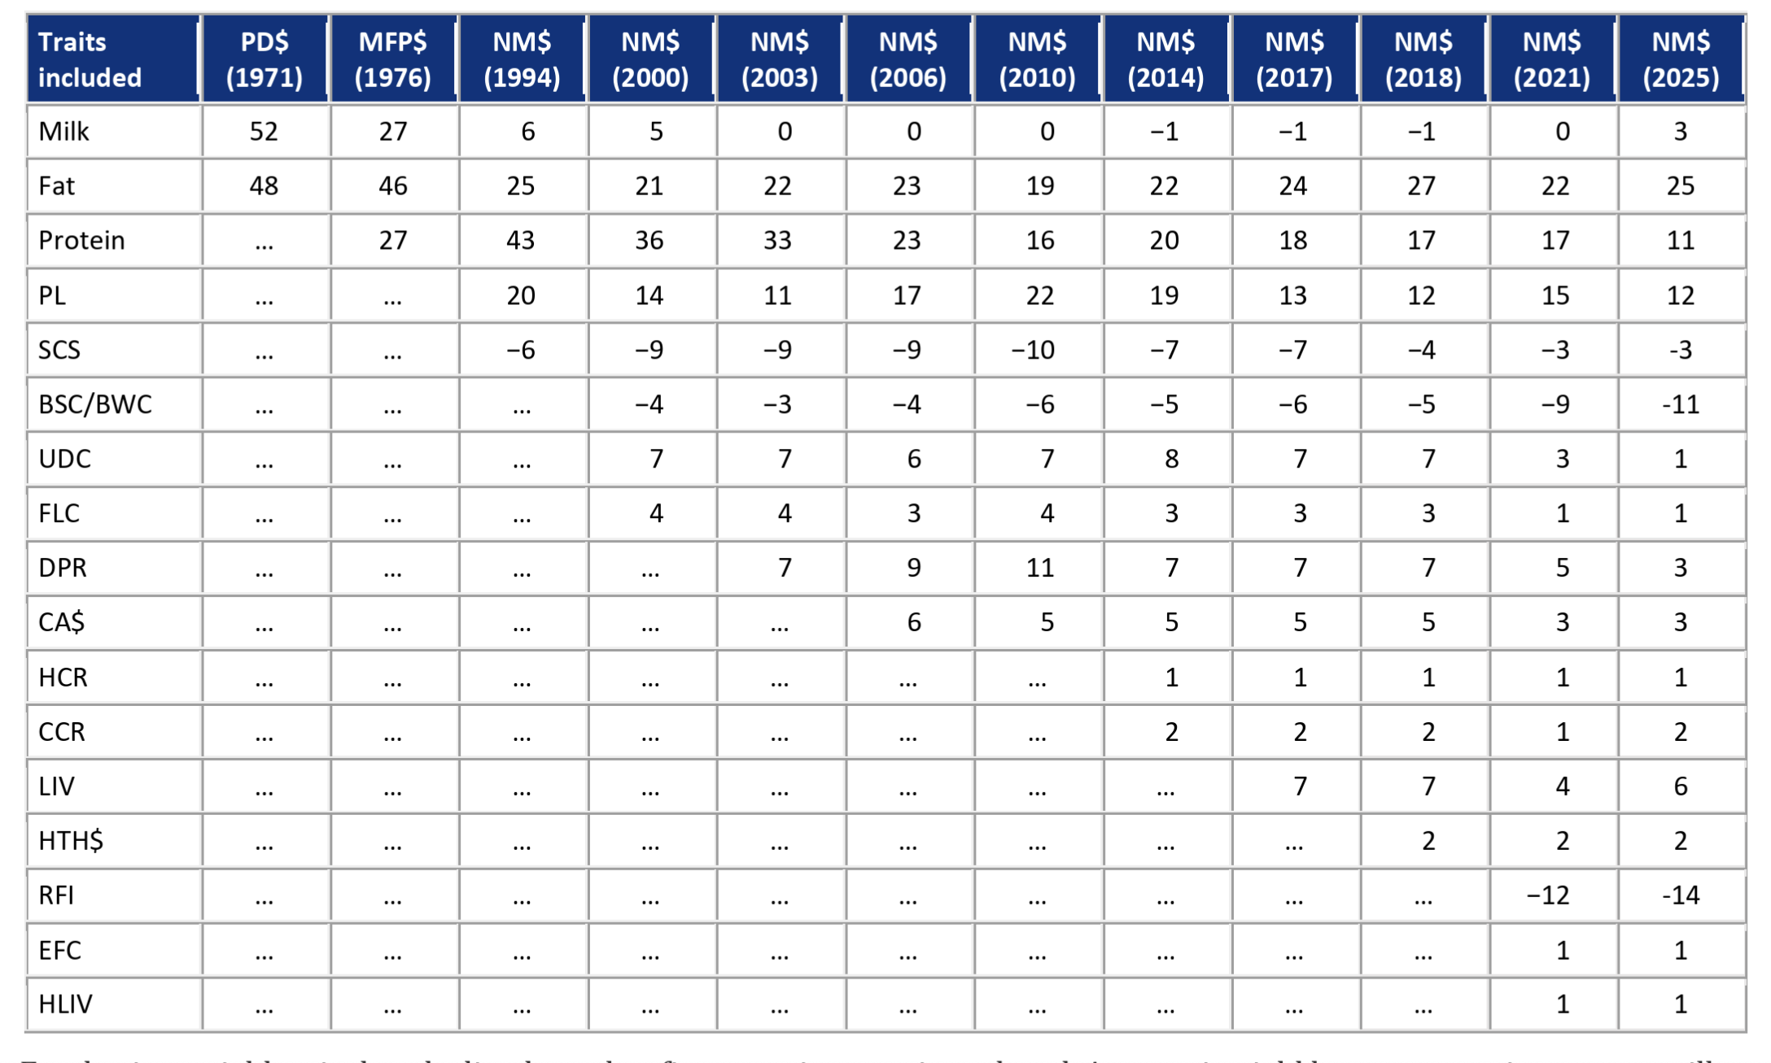
What are we selecting for?

Slide 22
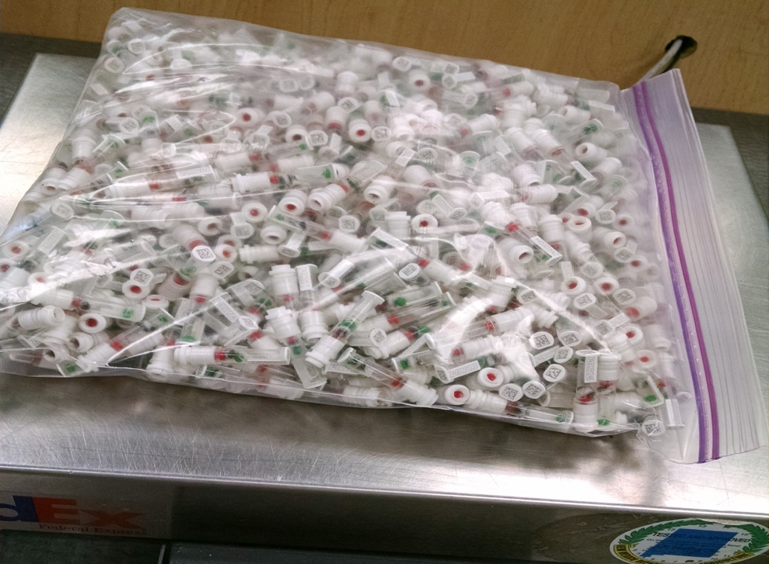
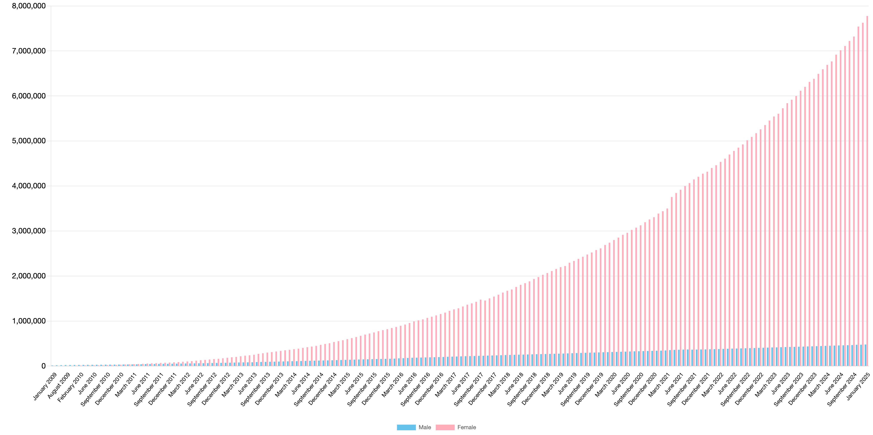
Genotypes are plentiful
Photo: Zoetis

Slide 23

Largest genomic databases
 | Ancestry.com | 23andMe | CDCB/USDA
Genotypes | >25 million | >12 million | >10 million
Species | Human | Human | Cattle
Countries | 88 | >55 | 57
Genotyping cost | $99 | $99 | ~$40+
Delivery (weeks) | 6–8 | “a few” | 1–2
DNA generations | Few | Few | >10
EBV reliability | None | Low | High
Source: https://www.23andme.com/; https://www.ancestry.com/corporate/about-ancestry/company-facts; https://queries.uscdcb.com/Genotype/counts.html.

Slide 24
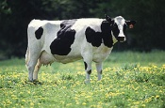
What do SNP genotypes do?
Pedigree information is equivalent to data on ~7 daus
For protein yield (h² = 0.30), a genotype provides information equivalent to an additional 34 daughters
Notes:
24

Slide 25
Genomics increased rates of gain

Slide 26
Why genomics works for dairy cattle
Extensive historical data available
Well-developed genetic evaluation program
Widespread use of artificial insemination
Progeny-test programs
High-value animals worth the cost of genotyping
Long generation interval that can be reduced substantially by genomics

Slide 27
What’s the best animal we can make?
PTA(NM$) = $3,652 = €3,295
The top bull is OCD THORSON RIPCORD-ET at $1,484
The top cow is GENOSOURCE 84298 KINKY P-ET at $1,548

Slide 28
US Holstein cattle (proven genotyped bulls)
Source: CDCB (2024)

Slide 29
Should we worry about inbreeding?
Change in phenotypic performance per 1% (0.25%) increase in inbreeding
Milk | Fat | Protein | PL | SCS | DPR | HCR | CCR | LIV
-72.4 | -2.66 | -2.08 | -0.28 | 0.01 | -0.20 | -0.21 | -0.29 | -0.10
-18.1 | -0.67 | -0.52 | -0.07 | 0.025 | -0.05 | -0.05 | -0.07 | -0.025
Source: CDCB (https://queries.uscdcb.com/eval/summary/Bmean_bases_het.cfm).
Change in genetic potential per year when selecting on NM$
Milk | Fat | Protein | PL | SCS | DPR | HCR | CCR | LIV
+126.9 | +7.7 | +4.4 | +0.49 | -0.02 | +0.03 | +0.15 | +0.15 | +0.25
Source: AGIL, ARS, USDA (https://www.ars.usda.gov/ARSUserFiles/80420530/Publications/ARR/nmcalc-2021_ARR-NM8.pdf).

Slide 30
Known genetic defects in US Holsteins
Haplo- Type | Functional/Gene name | BTA chromosome | Location (Mbp) | Haplotype frequency (%) | Timing¹
HCD | Cholesterol deficiency/APOB | 11 | 78.0 | 0.34 | W
HH0 | Brachyspina/FANCI | 21 | 21.2 | 0.28 | E,B
HH1 | APAF1 | 5 | 63.2 | 0.40 | E
HH2 | IFT80 | 1 | 107.1 | 0.68 | E
HH3 | SMC2 | 8 | 95.4 | 0.65 | E
HH4 | GART | 1 | 1.3 | 0.09 | E
HH5 | TFB1M | 9` | 91.28– 91.9 | 2.50 | E
HH6 | SDE2 | 16 | 29.0 | 1.14 | W
HHB | BLAD/ITGB2 | 1 | 145.1 | 0.03 | W
HHC | CVM/SLC35A3 | 3 | 43.4 | 0.25 | E,B
HHD | DUMPS/UMPS | 1 | 69.8 | 0.00 | E
HHM | Mule foot/LRP4 | 15 | 77.7 | 0.00 | B
HMW | Muscle weakness/CACNA1S | 16 | 79.6 | 2.04 | B
¹Timing of embryonic loss/calf death for homozygous animals: B = calf death at/shortly after birth,
E = embryonic loss/abortion, W = calf death weeks/months after birth (Cole et al., 2018).

Slide 31
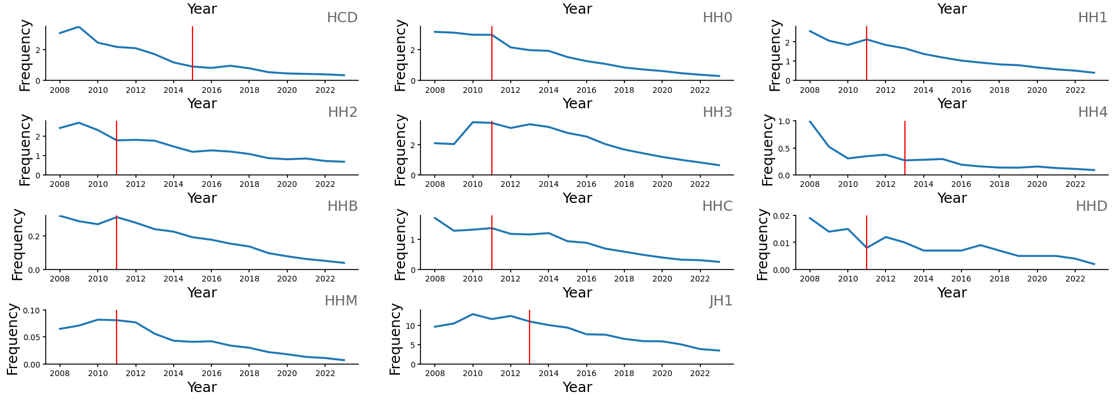
Changes in haplotype frequency
Cole et al. (2025, in press)

Slide 32
Is the number of defects increasing?
Cole et al. (2025, in press)

Slide 33
Conclusions
Genetic improvement programs have been very cost-effective tools for improving productivity
Genetic gains are cumulative and permanent, but genetic evaluations depend on a constant flow of data
The number of traits measured is growing but affordable data recording is challenging in some cases
Genetic diversity must be monitored to avoid long-term problems

Slide 34
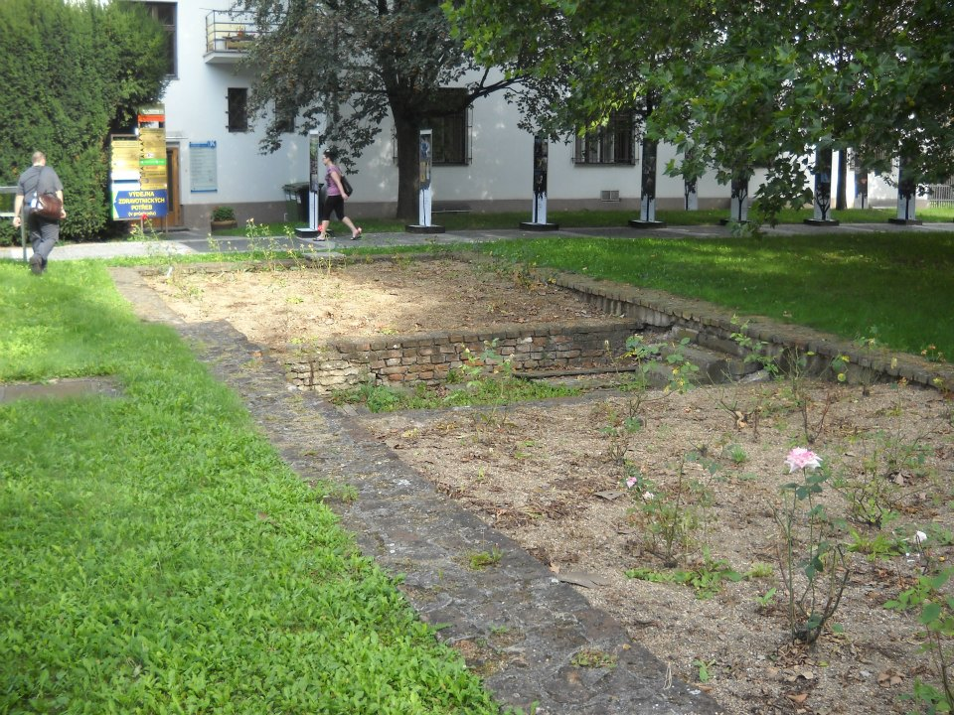
Questions?
Foundation of Gregor Mendel’s greenhouse, Brno, Czech Republic.

